Slide 1
CS 4476 Project 3
Kevin Liao
kliao2020@gatech.edu
903195635

Slide 2
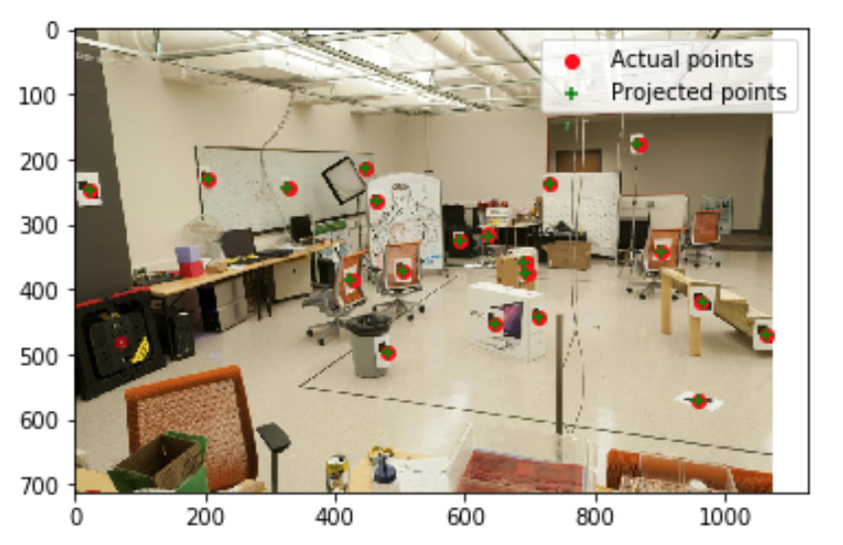
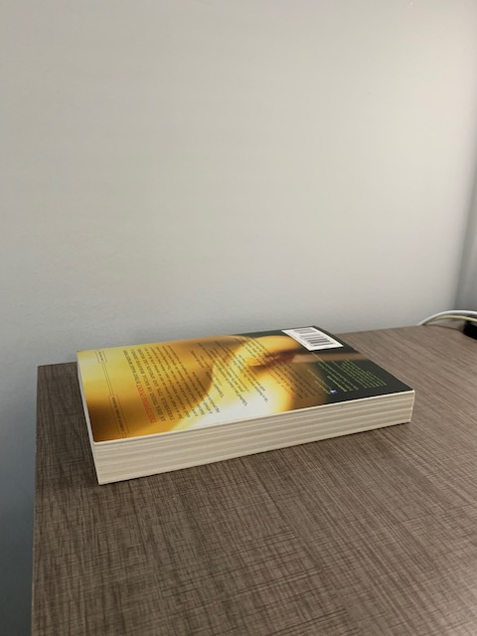

Part 1: Projection Matrix

Slide 3
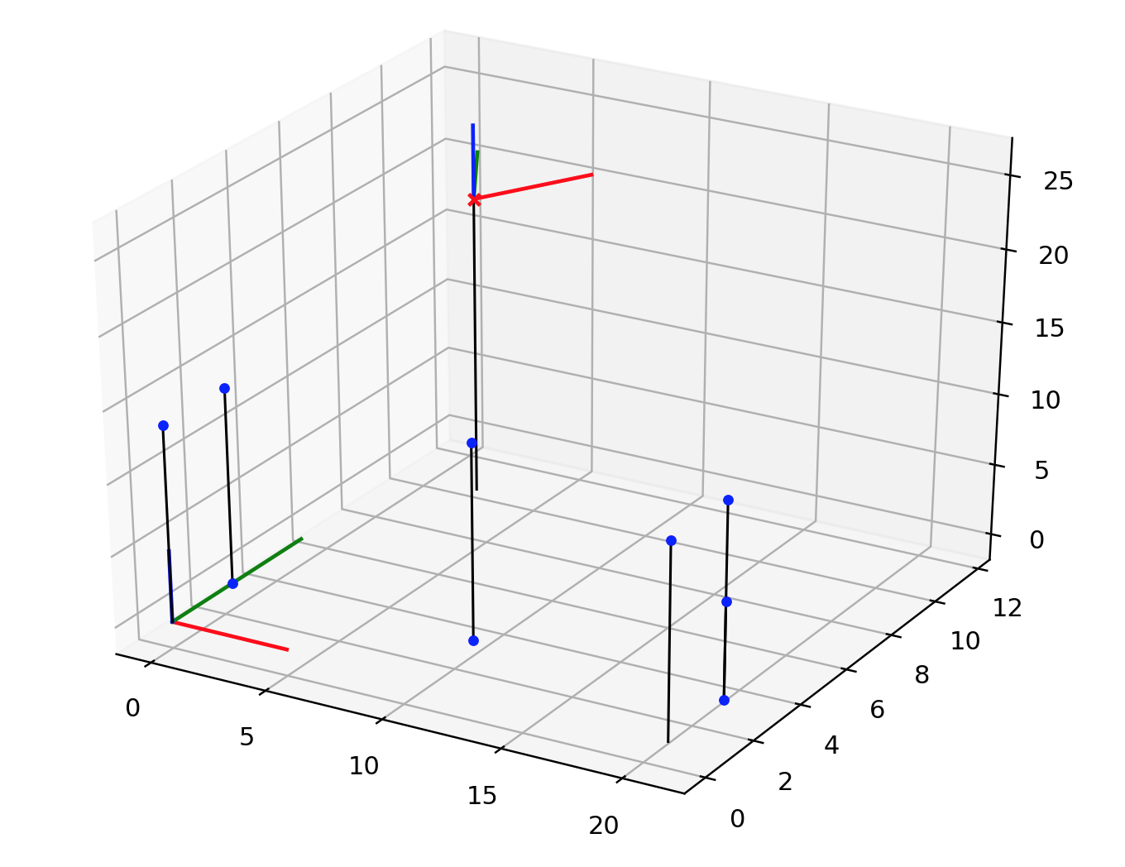
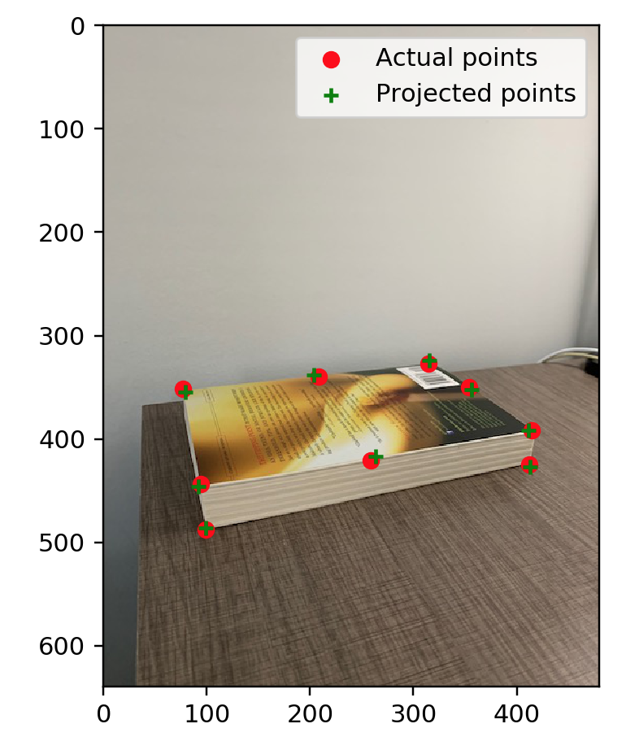
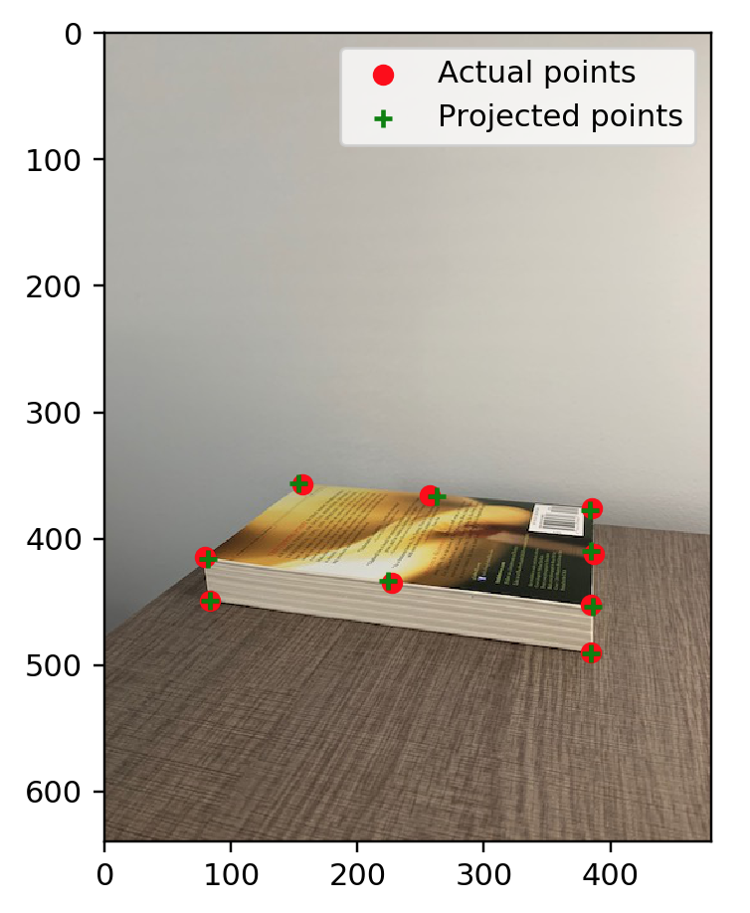
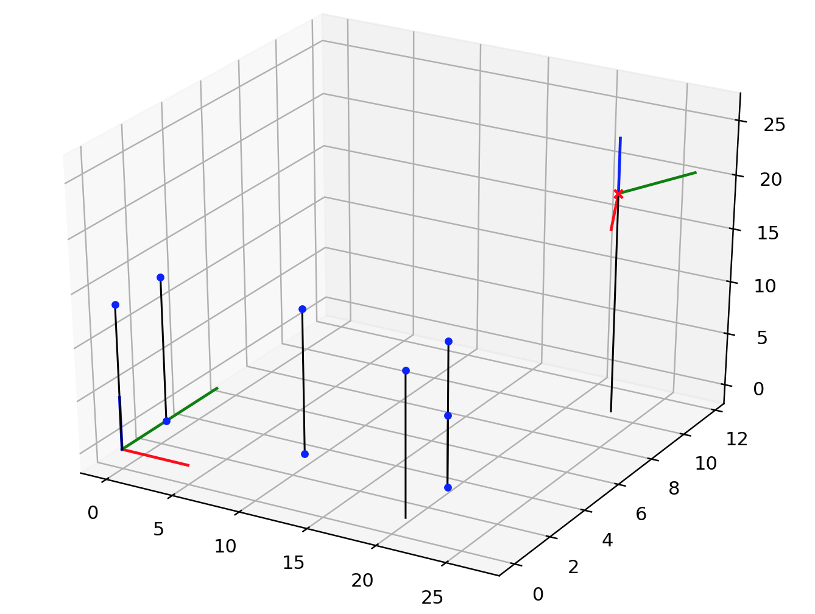
Part 1: Projection Matrix

Slide 4
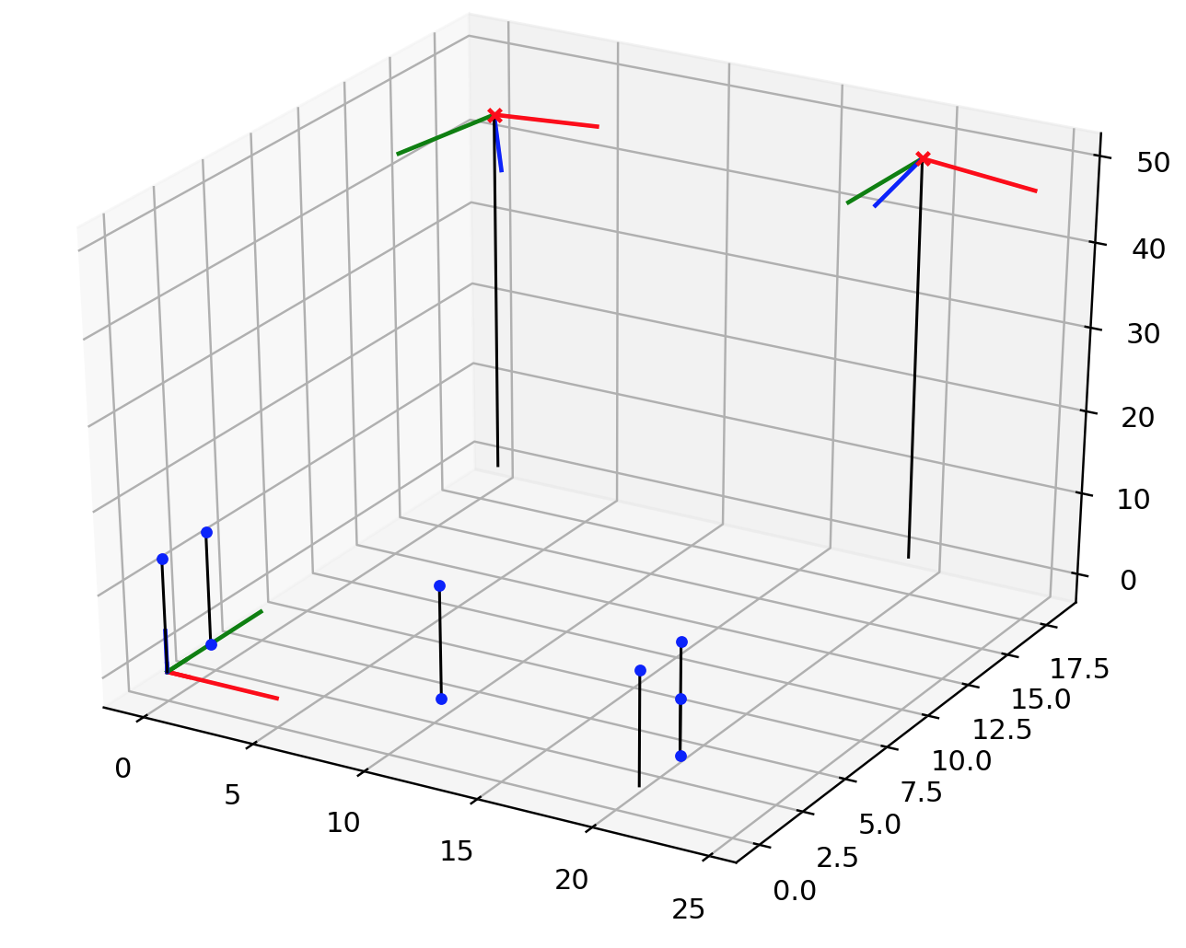
Part 1: Projection Matrix

Slide 5
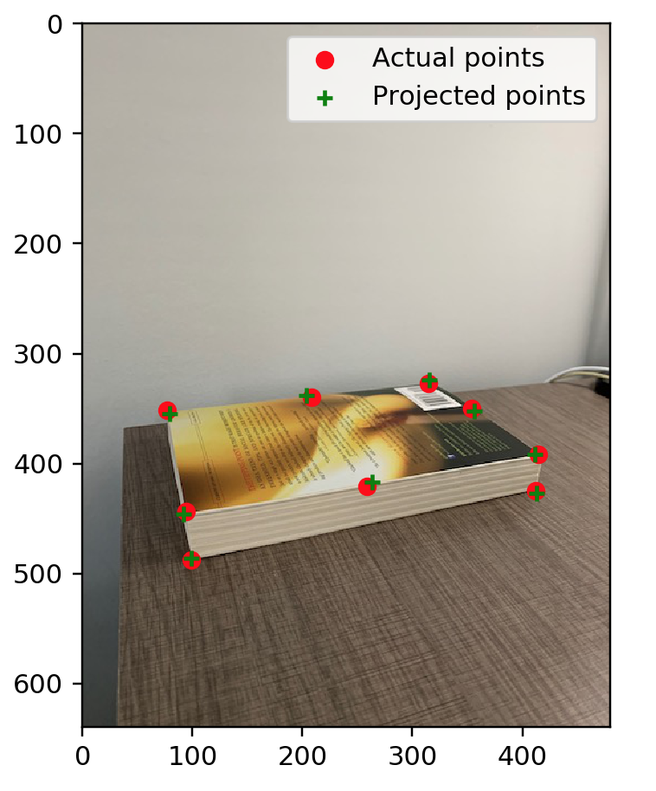
Part 1: Projection Matrix
1. I expect that the projected points wouldn’t change as long as the x, y, or z coordinates are increased/decreased to something that is still a reasonable initial estimate. This is because we optimize the reprojection loss using Levenberg-Marquardt.
This is the result that I expected. We see that the projection points are relatively the same. Additionally, the total residual was identical even after altering the initial camera coordinates.

Slide 6
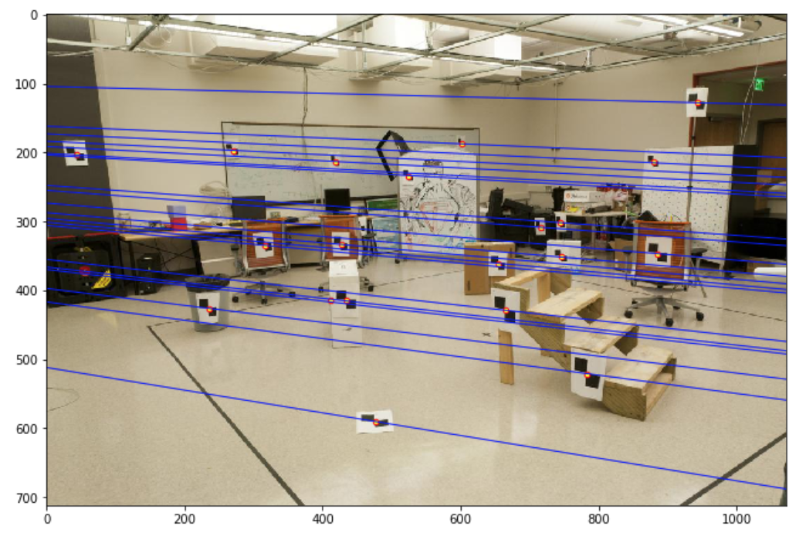
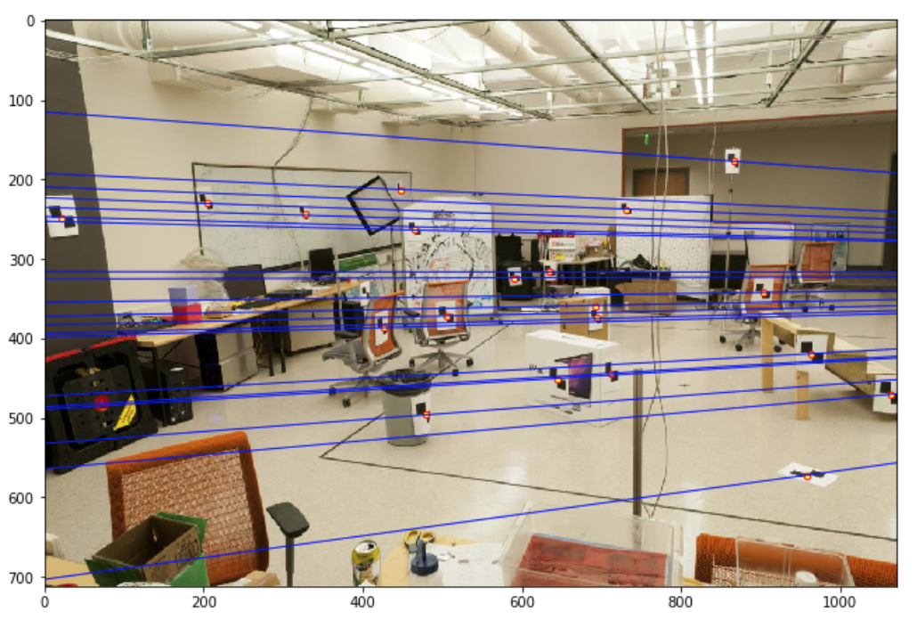
Part 2: Fundamental Matrix Estimation
Room: Left Image with Epipolar Lines
Room: Right Image with Epipolar Lines

Slide 7
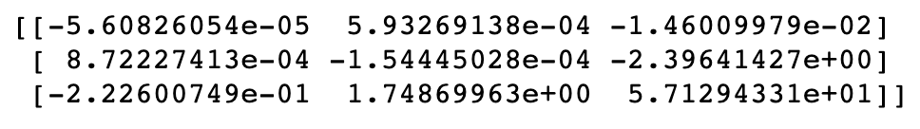
Part 2: Fundamental Matrix Estimation
Fundamental Matrix Estimation Result:

Slide 8
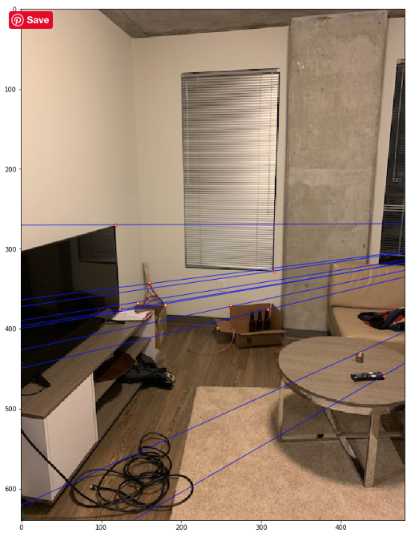
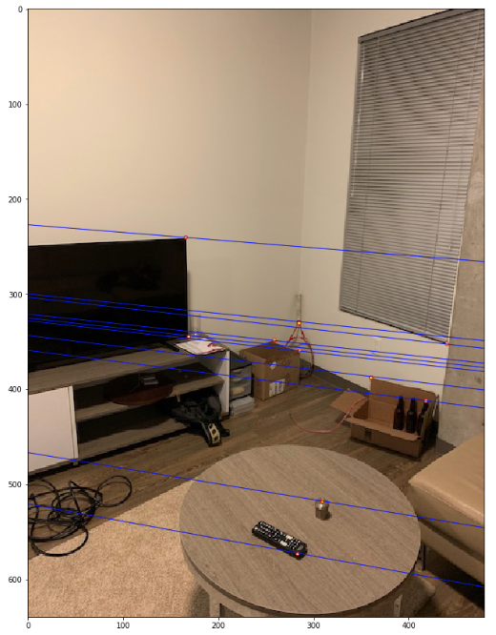
Part 2: Fundamental Matrix Estimation: Your Images
Your Image: Left Image with Epipolar Lines
Your Image: Right Image with Epipolar Lines

Slide 9
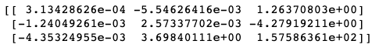
Part 2: Fundamental Matrix Estimation: Your Image
Fundamental Matrix Estimation Result:

Slide 10
Part 2: Reflection Questions
1. The fundamental matrix maps points in one view to a line in another view, so if we have two points that come from the same camera center, the epipolar lines will all be parallel and will not converge properly to an epipole.
2. Points in one image are projected into lines in another image because the projection is 2D, so we lose sense of depth. Therefore, from the viewpoint of the other camera, we need a line to represent all the possibilities of where that point could be.
3. The epipolar lines will converge to an epipole in camera in the image because the epipole is the image in one camera of the optical center of the other camera. One camera is within the scene of the other camera, which would mean the optical center of the outer camera would have to be in scene of the inner camera.
4. When epipolar lines are all horizontal across two images, this means that the optical centers of both cameras are not within the scenes of their respective photos.
5. The fundamental matrix is defined up to a scale because we don’t know the size of any objects in the scene, as this information is lost in a 3D-2D projection when 2D points are converted to homogeneous coordinates.
6. The fundamental matrix has a rank of 2 because it is mapping a 2D plane in one image to all the lines that pass through an epipole in image 2. The essential matrix E in F also has a rank of 2, so by matrix multiplication properties, F has a 0 determinant and a rank of 2.

Slide 11
Part 2: Extra Credit: Fundamental Matrix Song
Reflect on the Fundamental Matrix Song
Link here: https://www.youtube.com/watch?v=DgGV3l82NTk
<write a couple sentences about the Fundamental Matrix Song and what you learned>

Slide 12
Part 3: RANSAC Iterations Questions
14 iterations
42 iterations
167 iterations for 9 point correspondences and 4238 iterations for 18 point correspondences

Slide 13
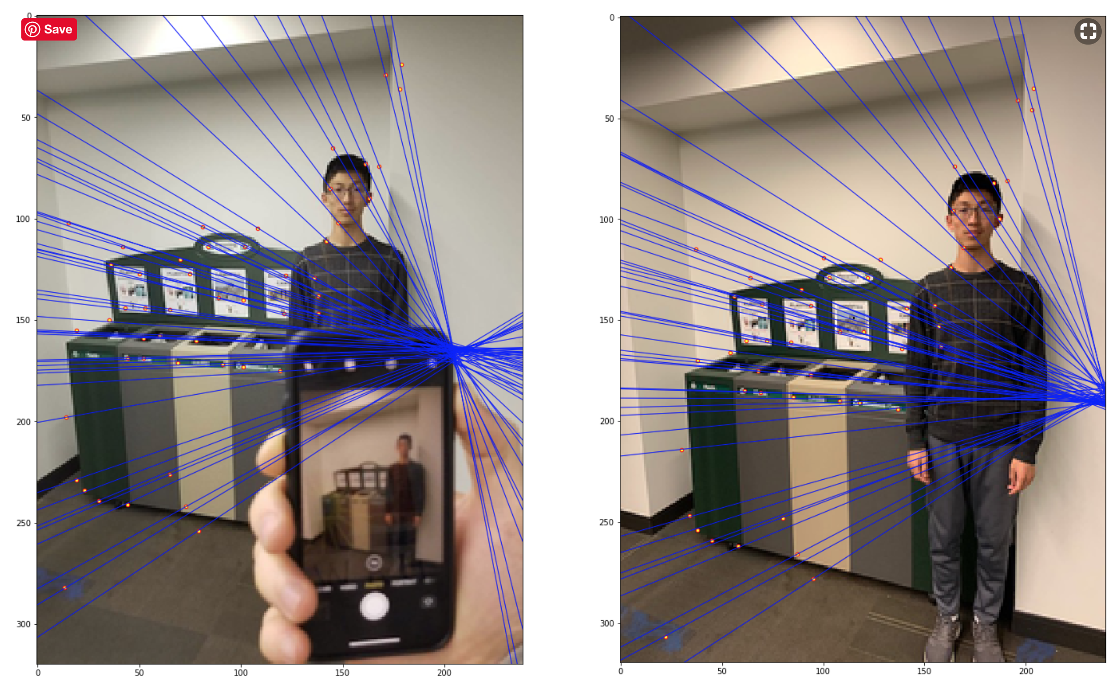
Part 3: RANSAC Implementation

Slide 14
Part 3: RANSAC Extra Credit!!!
Paste a second image pair that you created demonstrating the use of your RANSAC algorithm in a different environment, and reflect on how your code relates to the RANSAC song. https://www.youtube.com/watch?v=1YNjMxxXO-E

Slide 15
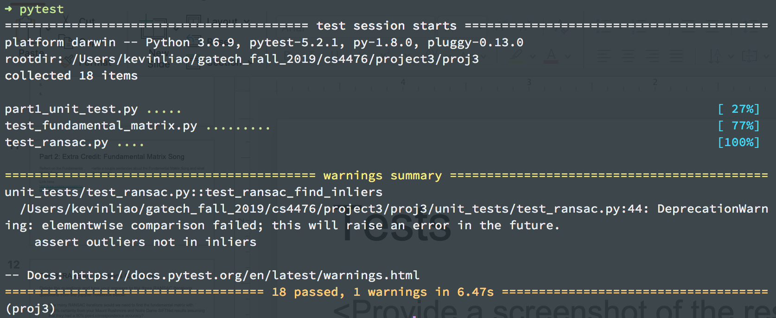
Tests

Slide 16
Conclusions
In this project, I have learned about how to estimate the camera projection matrix in order to project 3D world coordinates to 2D image coordinates. I have also learned how to estimate the fundamental matrix in order to correlate the optical centers of two cameras that have taken a photo of the same scene. Additionally, it was interesting to see what sets of photos are best for estimating the fundamental matrix and how accurate a least-squares error approach can be for finding a good projection matrix. Finally, I learned how RANSAC can be more advantageous than least-squares when finding the best model for matching points in two images.

Slide 17
Code results (do not modify this slide!)
Part 1
Part 2
Part 3

